Slide 1
ETH PAURA Human-Elephant Conflict Mitigation system and Information sharing hub
THIRD PROGRESS DEMONSTRATION

Slide 2
Human Elephant Mitigation System
Detect Elephant invasions
Determine the direction of the breach ( eg: North, west etc..)
Identify Leaving and Entering situations
Eliminate false triggers
Send SMS Villagers
Notify Forest Officers via SMS or push notifications
Notify the Village via alarms
Update database

Slide 3
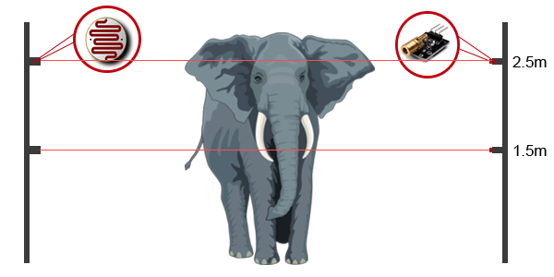
Front View

Slide 4
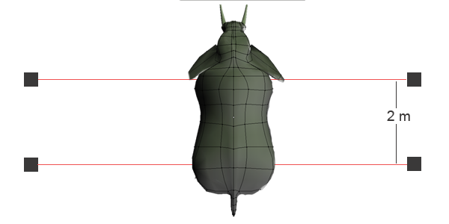
Top View

Slide 5
Data Analyzer
Get data from the collar
Simulator using socket programming
Send data at predefined intervals
Update database tables
Analyze data to predict critical situations
Trapped incidents
Health conditions
Notify wild life officers
Update database

Slide 6
Information Sharing Hub
Front-end
This is to share research information, elephant position updates, etc..
Back-end
Manipulate information about elephants and users of information hub.
Allow to control information hub to authorized persons.

Slide 7
Underline functionalities I added..
Session Handling and session time out in 20 secs if no request
Spring Security – URL blocking and handling
Password Hashing
Remember me Authentication and blocking remember me logged users from secured functions
Cache clearing and logout
Remember me Authentication
Spring Oauth
Filtering search using criteria

